Slide 1

Library Management System
A Full-Stack Web Application for Efficient Library Operations
Bereket shegye 1501043
Dagimawit Kelem 1501101
Ashenafi Abera 1403014
Fikire Tibebu 0737/13
Yordanos Dejene 1403192
by Bereket Shegye

Slide 2

Introduction & Project Overview
Comprehensive Web App
Solves Inefficiencies
Manages library resources: books, borrowers, loans.
Addresses manual tracking, availability, and centralization.
Key Objectives
Secure access, efficient operations, intuitive UI, accurate tracking.

Slide 3
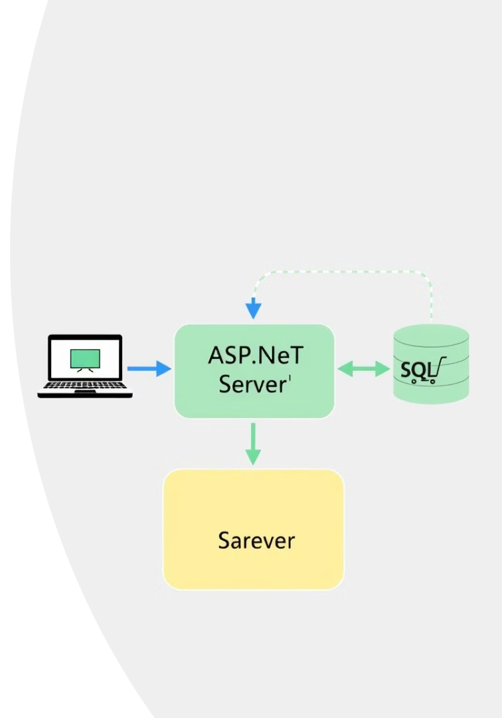



Project Architecture
Client (Frontend)
React.js Web Application
Server (Backend)
ASP.NET Core Web API
Database
SQL Server

Slide 4
Technology Stack
Frontend
Backend
Other Tools
React.js: Dynamic UI
ASP.NET Core Web API: Robust APIs
Visual Studio / VS Code: Dev environments
JavaScript (ES6+): Logic
HTML/CSS: Structure/Styling
C#: Programming language
Git / GitHub: Version control
npm: Package manager
Entity Framework Core: ORM
SQL Server: Data storage
NuGet: Package manager

Slide 5

Key Endpoints & API Design
RESTful Principles
Core API Examples
Resource-oriented, standard HTTP methods, stateless.
Auth: register, login. Books: GET, POST, PUT, DELETE.
Example Request
Add Book: title, author, isbn, publicationYear, genre, isAvailable.

Slide 6




Security Design
Authentication
JWT (JSON Web Tokens) for secure login.
Authorization
Authorize attribute enforces access control.
CORS
Cross-Origin Resource Sharing enabled for frontend.

Slide 7


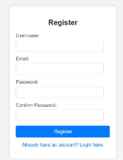
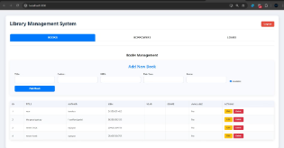
Demo - User Authentication
Login Page
Secure access to the library system.
Registration Page
Allows new library staff to create an account.
Live Demonstration
See core functionalities in action.

Slide 8
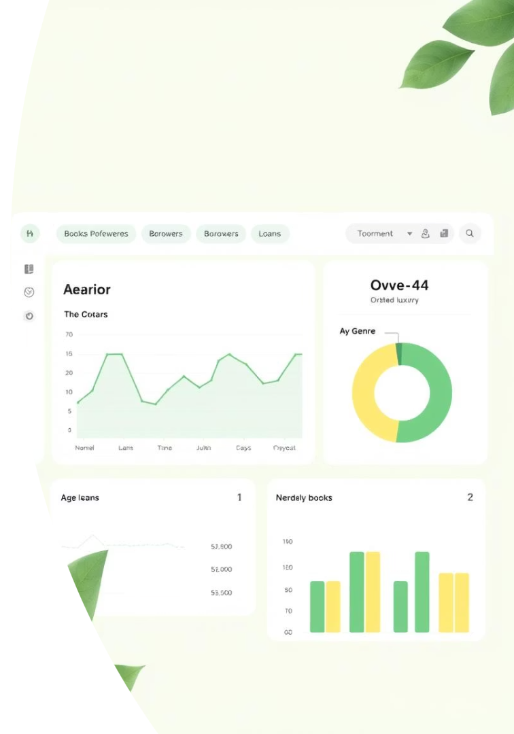

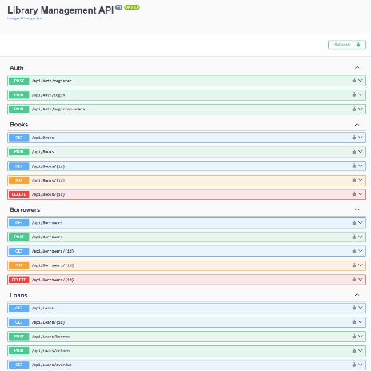

Core Functionality
Main Dashboard
Intuitive tab-based navigation.
Books Management
Add, view, edit, delete books. ISBN validation.

Slide 9



Core Functionality
Loans Management
1
Track loans, record borrowings, mark returns.
Book Availability
2
Ensures accurate status updates.
Borrowers Management
3
Manage patrons and contact info.

Slide 10

Team Roles & Individual Contributions
bereket shegye
Designed/implemented ASP.NET Core API for Books, Borrowers, Loans.
dagimawit and ashenafi
Set up JWT authentication, CORS. Developed React components for auth/dashboard.
fikre and yordanos
Integrated frontend/backend, configured EF Core migrations, SQL Server, UI/UX.

